Slide 1
Object Tracking using Particle Filter
Nandini Easwar
Jogen Shah
CIS 601, Fall 2003

Slide 2
Overview
Background Information
Basic Particle Filter Theory
Rao Blackwellised Particle Filter
Color Based Probabilistic Tracking

Slide 3
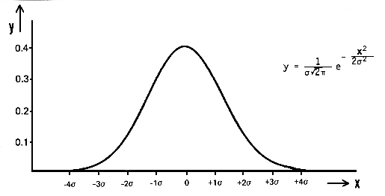
Object Tracking
Tracking objects in video involves the modeling of non-linear and non-gaussian systems.
Non-Linear
Non-Gaussian

Slide 4
Background
In order to model accurately the underlying dynamics of a physical system, it is important to include elements of non-linearity and non-gaussianity in many application areas.
Particle Filters can be used to achieve this.
They are sequential Monte Carlo methods based on point mass representations of probability densities, which are applied to any state model.

Slide 5
The Particle Filter
Particle Filter is concerned with the problem of tracking single and multiple objects.
Particle Filter is a hypothesis tracker, that approximates the filtered posterior distribution by a set of weighted particles.
It weights particles based on a likelihood score and then propagates these particles according to a motion model.

Slide 6
Mathematical Background
Particle Filtering estimates the state of the system, x t, as time t as the Posterior distribution:
P( x _{t} | y _{0-t} )
Let,
Est (t) = P( x _{t} | y _{0-t} )
Est(1) can be initialized using prior knowledge

Slide 7
Mathematical Background
Particle filtering assumes a Markov Model for system state estimation.
Markov model states that past and future states are conditionally independent given current state.
Thus, observations are dependent only on current state.

Slide 8
Mathematical Background
Est(t) = P( x _{t} | y _{0 - t} )
= p(y _{t} | x _{t}, y _{0 – t-1}).P(x _{t} | y _{0 – t-1})
(Using Baye’s Theorem)
= p(y _{t} | x _{t} ). P(x _{t} | y _{0 – t-1})
(Using Markov model)
= p(y _{t} | x _{t} ). P(x _{t} |x _{t-1}).P(x _{t-1} | y _{0 – t-1})
= p(y _{t} | x _{t} ). P(x _{t} |x _{t-1}).Est(t-1)

Slide 9
Mathematical Background
Final Result:
Est(t) = p(y _{t} | x _{t} ). P(x _{t} |x _{t-1}).Est(t-1)
Where:
  p(y _{t} | x _{t} ): Observation Model
  P(x _{t} |x _{t-1}).Est(t-1): Proposal distribution

Slide 10
Mathematical Background
To implement Particle Filter we need
  State Motion model: P(x _{t} |x _{t-1})
  Observation Model: p(y _{t} | x _{t} ):
  Initial State: Est(1)

Slide 11
Mathematical Background
We sample from the proposal and not the posterior for estimation.
To take into account that we will be sampling from wrong distribution, the samples have to be likelihood weighed by ratio of posterior and proposal distribution:
W t = Posterior i.e.Est (t) / proposal Distribution
= p(y _{t} | x _{t} )
Thus, weight of particle should be changed depending on observation for current frame.

Slide 12
Basic Particle Filter Theory
A discrete set of samples or particles represents the object-state and evolves over time driven by the means of "survival of the fittest". Nonlinear motion models can be used to predict object-states.

Slide 13
Basic Particle Filter Theory (Cont.)
Particle Filter is concerned with the estimation of the distribution of a stochastic process at any time instant, given some partial information up to that time.
The basic model usually consists of a Markov chain X and a possibly nonlinear observation Y with observational noise V independent of the signal X.

Slide 14
Basic Particle Filter Theory (Cont.)
System Dynamics ie.Motion Model:
p(x _{t}| x _{0:t-1})
Observation Model:
p(y _{t} | x _{t})
Posterior Distribution:
p(x _{t} | y _{o..t})
Proposal Distribution is the Motion Model
Weight, w _{t} = Posterior / Proposal = observation

Slide 15
Basic Particle Filter Theory (Cont.)
Given N particles (samples) {x^{(i)}_{0:t-1},z^{(i)}_{0:t-1}}^{N}_{i=1} at time t-1, approximately distributed according to the distribution P(dx^{(i)}_{0:t-1},z^{(i)}_{0:t-1}|y_{1:t-1}), particle filters enable us to compute N particles {x^{(i)}_{0:t},z^{(i)}_{0:t}}^{N}_{i=1} approximately distributed according to the posterior distribution P(dx^{(i)}_{0:t},z^{(i)}_{0:t}|y_{1:t})

Slide 16
Basic Particle Filter Theory (Cont.)
The basic Particle Filter algorithm consists of 2 steps:
  Sequential importance sampling step
  Selection step

Slide 17
Particle Filter Algorithm
Sequential importance sampling
  Uses Sequential Monte Carlo simulation.
    For each particle at time t, we sample from the transition priors
    For each particle we then evaluate and normalize the importance weights.

Slide 18
Particle Filter Algorithm
Selection Step
  Multiply or discard particles with respect to high or low importance weights w^{(i)}_{t} to obtain N particles.
  This selection step is what allows us to track moving objects efficiently.

Slide 19
Rao-Blackwellised Particle Filter
RBPF is an extension on PF.
It uses PF to compute the distribution of discrete state with Kalman Filter to compute the distribution of continuous state.
For each sample of the discrete states, the mean and covariance of the continuous state are updated using the exact computations.
We have implemented the particle filter algorithm and not the RBPF.

Slide 20
RBPF Approach
RBPF models the states as <C_{t},D_{t}>
  C_{t} is the continuous state representation
  D_{t} is the discrete state representation
The aim of this approach is to predict the discrete state D_{t.}
However, for our object tracking application, the above approach was unsuitable.

Slide 21
Implementation
We have implemented the Particle Filter algorithm in Matlab.
Our approach towards this project:
  Reading research papers on PF given to us by Dr.Latecki.
  Trying to implement PF-RBPF algorithm written by Nando de Freitas.

Slide 22
Implementation
Color Based Probabilistic Tracking
  These trackers rely on the deterministic search of a window, whose color content matches a reference histogram color model.
  Uses principle of color histogram distance.
This color based tracking is very flexible and can be extended in many ways.

Slide 23
Color Based Probabilistic Tracking
The combination of tools used to accomplish a given tracking task depends on whether one tries to track:
  Objects of a given nature eg.cars,faces
  Objects of a given nature with a specific attribute eg.moving cars, face of specific person
  Objects of unknown nature, but of specific interest to us eg.moving objects.

Slide 24
Color Based Probabilistic Tracking
Reference Color Window
  The target object to be tracked forms the reference color window.
  Its histogram is calculated, which is used to compute the histogram distance while performing a deterministic search for a matching window.

Slide 25
Color Based Probabilistic Tracking
State Space
  We have modeled the states, as its location in each frame of the video.
  The state space is represented in the spatial domain as:
    X = ( x , y )
  We have initialized the state space for the first frame manually.

Slide 26
Color Based Probabilistic Tracking
System Dynamics
  A second-order auto-regressive dynamics is chosen on the parameters used to represent our state space i.e (x,y).
  The dynamics is given as:
    X_{t+1} = Ax_{t} + Bx_{t-1}
    Matrices A and B could be learned from a set of sequences where correct tracks have been obtained.
    We have used an ad-hoc model for our implementation.

Slide 27
Color Based Probabilistic Tracking
Observation y_{t}
  The observation y_{t} is proportional to the histogram distance between the color window of the predicted location in the frame and the reference color window.
  Y_{t} α Dist(q,q_{x}),
    Where
    q = reference color histogram.
    qx = color histogram of predicted location.

Slide 28
Color Based Probabilistic Tracking
Particle Filter Iteration
  Steps:
  Initialize xt for first frame
  Generate a particle set of N particles {x^{m}_{t}}_{m=1..N}
  Prediction for each particle using second order auto-regressive dynamics.
  Compute histogram distance
  Weigh each particle based on histogram distance
  Select the location of target as a particle with minimum histogram distance.
  Sampling the particles for next iteration.

Slide 29
Color Based Probabilistic Tracking
An step by step look at our code, highlighting the concepts applied:
  Initialization of state space for the first frame and calculating the reference histogram:
    reference = imread('reference.jpg');
    [ref_count,ref_bin] = imhist(reference);
    x1= 45; y1= 45;
  Describing the N particles within a specified window:
    for i = 1:N
    x(1,i,1) = x1 + 50 * rand(1) - 50 *rand(1);
    x(2,i,1) = y1 + 50 * rand(1) - 50 *rand(1);
    end

Slide 30
Color Based Probabilistic Tracking
For each particle, we apply the second order dynamics equation to predict new states:
  if (j==2) x(:,i,j) = A * x(:,i,j-1);
  else x(:,i,j)=rand(n_x)*x(:,i,j-1)+rand(n_x)*x(:,i,j-2);
The color window is defined and the histogram is calculated:
  rect = [(x(1,i,j)-15),(x(2,i,j)-15),30,30];
  [count,binnumber] = imhist(imcrop(I(:,:,:,j),rect));

Slide 31
Color Based Probabilistic Tracking
Calculate the histogram distance:
  for k = 1:255
  d( I , j ) = d( i, j ) + (double ( count ( k ) ) - double(ref_count( k ) ) ) ^ 2;
  end
Calculating the normalized weight for each particle:
  w(:,j) = w(:,j)./sum(w(:,j));
  w(:,j) = one(:,1) - w(:,j);

Slide 32
Color Based Probabilistic Tracking
Re-sampling step, where the new particle set is chosen:
  for i = 1:N
  x(1,i,j) = state(1,j) + 50 * rand(1) - 50 *rand(1);
  x(2,i,j) = state(2,j) + 50 * rand(1) - 50 *rand(1);
  end

Slide 33
Color Based Probabilistic Tracking
Functions Used:
  Track_final1.m : PF tracking code
  multinomialR.m : Resampling function.

Slide 34
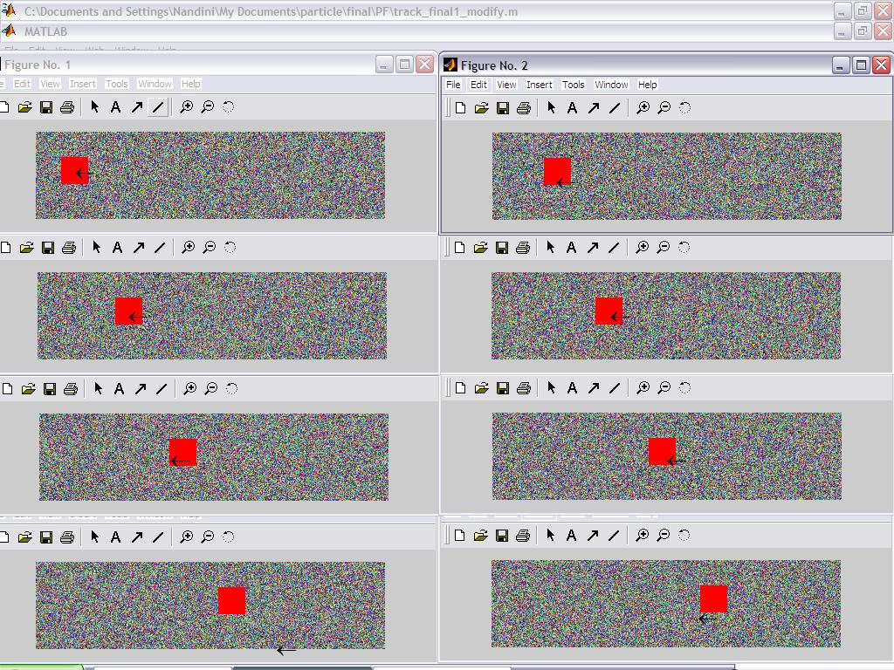
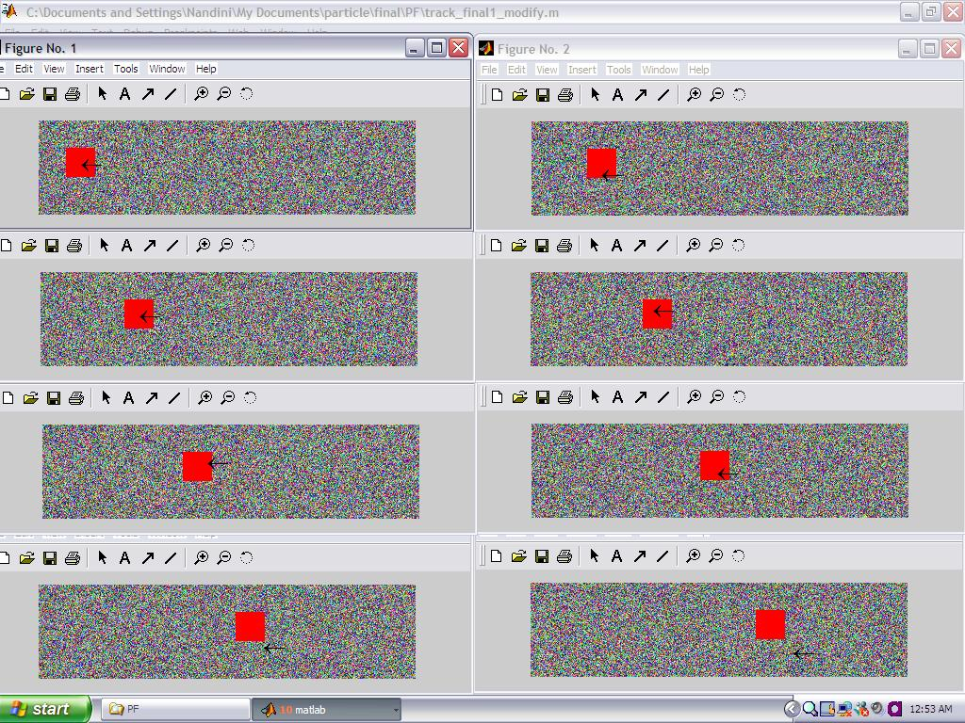
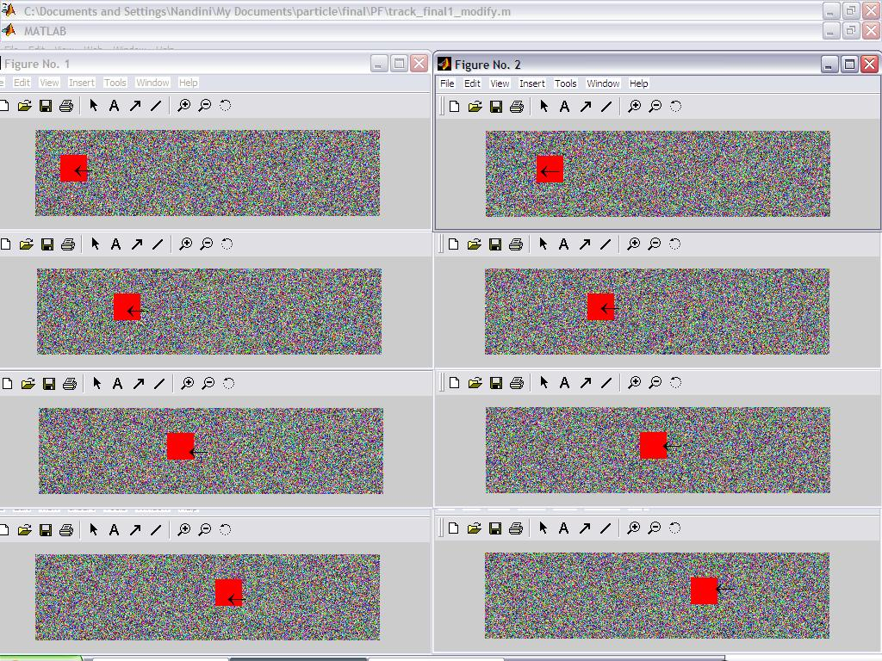

Color Based Probabilistic Tracking: Results

Slide 35
Applications
Video Surveillance
Gesture HCI
Reality and Visual Effects
Medical Imaging
State estimation of Rovers in outer-space.

Slide 36
Future Work
Automatic initialization of reference window.
Multi part color window.
Multi-object tracking.

Slide 37
References
M. Isard and A. Blake. Condensation–conditional density propagation for visual tracking. Int. J. Computer Vision, 29(1):5–28, 1998.
D. Reid, “An algorithm for tracking multiple targets,” IEEE Trans. on Automation and Control, vol. AC-24,pp. 84–90, December 1979.
N. Gordon, D. Salmond, and A. Smith, “Novel approach to nonlinear/non-Gaussian Bayesian state estimation,” IEEE Procedings F, vol. 140, no. 2, pp. 107–113, 1993.
S. Arulampalam, S. Maskell, N. Gordon, and T. Clapp, “A tutorial on particle filters for on-line non-linear/non-Gaussian Bayesian tracking,” IEEE Transactions on Signal Processing, vol. 50, pp. 174–188, Feb. 2002.

Slide 38
Thank You

